Slide 1
Virtual Memory
What is virtual memory?
Why it is used?
Mapping—virtual address to physical address
Address space and memory space

Slide 2
Computer with a main-memory capacity of 32K words (K = 1024). Fifteen bits are needed to specify a physical address in memory
Auxiliary memory for storing 2^20 = 1024K words. auxiliary memory has a capacity for storing information equivalent to the capacity of 32 main memories.
If we denote address space by N and the memory space by M, we have N = 1024K and M = 32K.

Slide 3
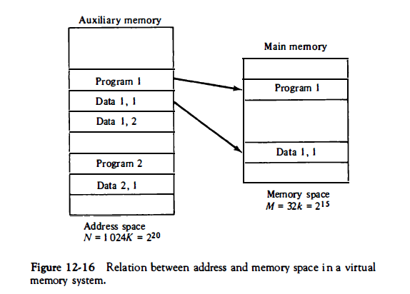

Slide 4
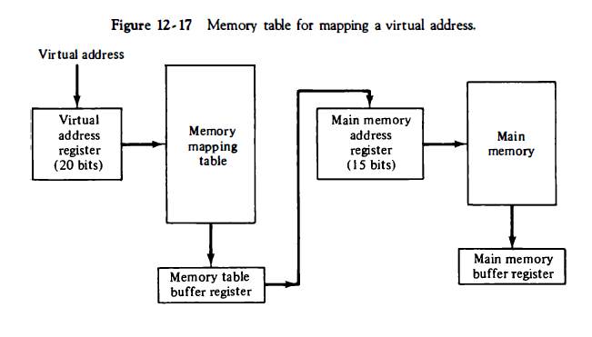

Slide 5
Address mapping using pages
Pages and blocks(frames)
Both are of equal size why??
Programs are divided into pages
Logical address divided into two parts
Page number and offset (address)
Physical address divided into two parts
Frame number and offset
Offset is same for both
Only page number and block number mapping required

Slide 6
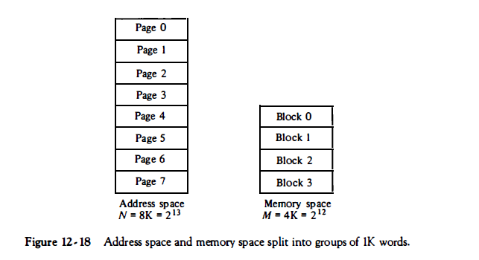

Slide 7
Page Replacement
When page is not found in main memory?
Which page is to be removed for new page?
When new page is transferred from auxi. To main memory?
Where to be placed in main memory?
Page fault
Page replacement algorithms
Mostly used algorithms are FIFO and LRU

Slide 8
Page and Frame Replacement Algorithms
Page-replacement algorithm
Want lowest page-fault rate on both first access and re-access
Evaluate algorithm by running it on a particular string of memory references (reference string) and computing the number of page faults on that string
String is just page numbers, not full addresses
Repeated access to the same page does not cause a page fault
Results depend on number of frames available
Notes:
‹#›

Slide 9
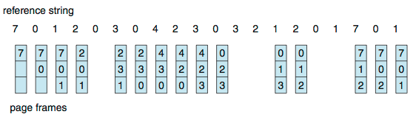
First-In-First-Out (FIFO) Algorithm
Reference string: 7,0,1,2,0,3,0,4,2,3,0,3,0,3,2,1,2,0,1,7,0,1
3 frames (3 pages can be in memory at a time per process)
15 page faults
Notes:
‹#›

Slide 10
Can vary by reference string: consider 1,2,3,4,1,2,5,1,2,3,4,5
Adding more frames can cause more page faults!
Belady’s Anomaly
How to track ages of pages?
Just use a FIFO queue

Slide 11
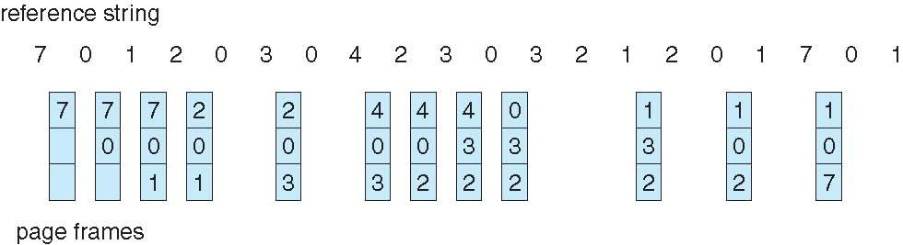
Least Recently Used (LRU) Algorithm
Use past knowledge
Replace page that has not been used in the most amount of time
Associate time of last use with each page
12 faults – better than FIFO
Generally good algorithm and frequently used
But how to implement?
Notes:
‹#›

Slide 12
Counter implementation
Every page entry has a counter; every time page is referenced through this entry, copy the clock into the counter
When a page needs to be changed, look at the counters to find smallest value
Search through table needed
Stack implementation
Notes:
‹#›

Slide 13
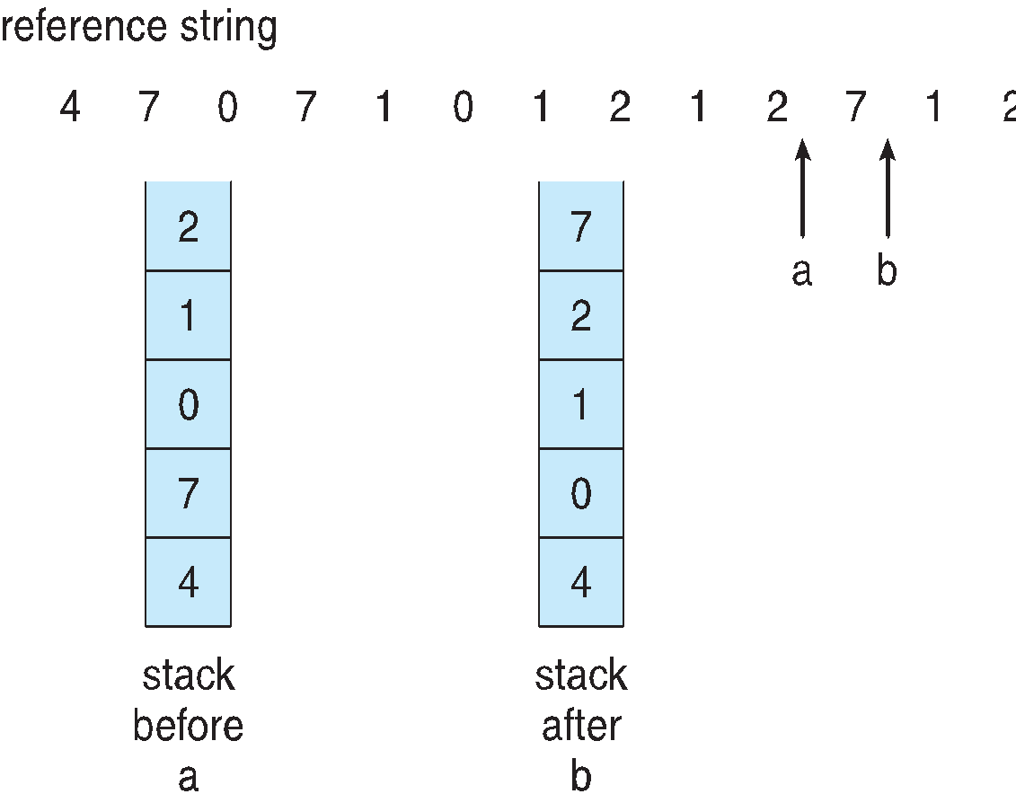
Use Of A Stack to Record Most Recent Page References
Notes:
‹#›

Slide 14
Memory Management Hardware
Basic components of MMH
Mapping logical address to physical address
Sharing programs to different users
Protect information against unauthorized access
Preventing users from changing OS functions

Slide 15
Segment
Difficulties with paging system
Programs are divide into logical parts known as segment
Set of logically related data
May be generated by programmer or OS
Examples of segments are subroutine, array of data, table of symbols or user’s program
In 8086 microprocessor segments are code segment,data segment , stack segment ,extra segment

Slide 16
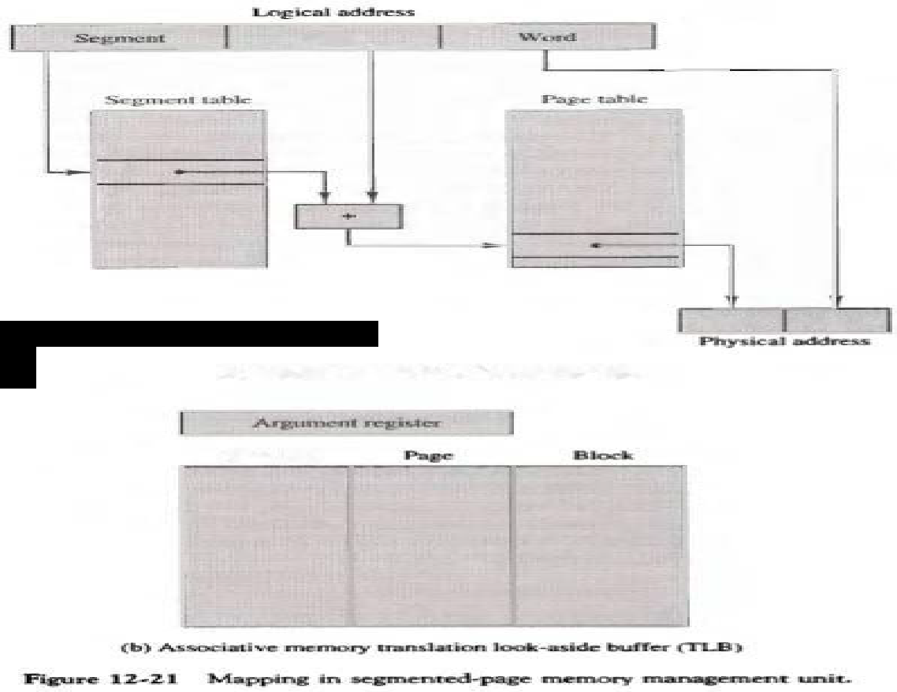
Segmented page mapping

Slide 17
Translation Lookaside Buffer (TLB)
Fast associative memory to hold most recently referenced table entries.
TLB is to virtual memory is like cache to main memory

Slide 18
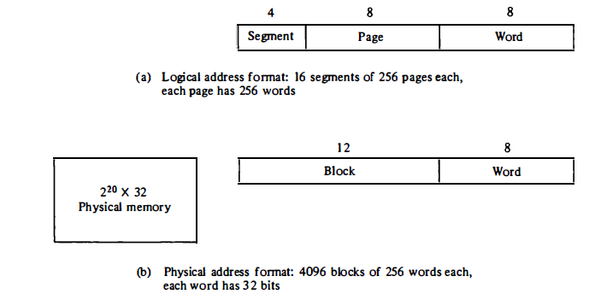

Slide 19
In an example 20 –bit logical address is divided into 3 parts:
4-bit segment number ( 16 possible segments)
8-bit page number ( can specify upto 256 pages)
8-bit word field ( page size of 256 words)
This configuration allows each segment to have any number of pages upto 256
The smallest possible segment will have one page or 256 words
Largest possible segment will have 256 pages , so 256 x 256= 64 K words

Slide 20
Physical memory is of 2^20 words of 32 bits each
So 20- bit address is divided into two fields:
12- bit block number (4096 blocks)
8- bit word number (256 words)
A page in a logical address has a corresponding block in physical memory
Both the logical and physical address have 20 bits

Slide 21
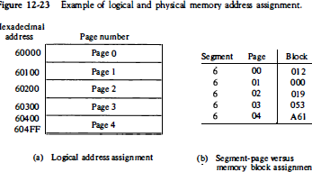

Slide 22
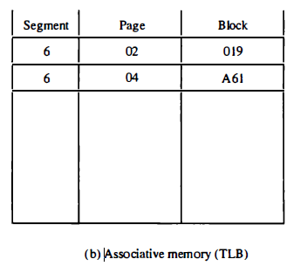

Slide 23
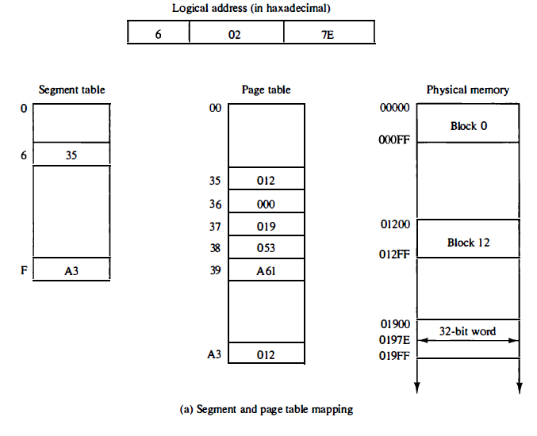

Slide 24
Memory Protection
Protection bit
Segment descriptor---Base address, length, protection bit
Access rights
Full read and write privileges (when program is executing its own instructions)
Read only (write protection) –sharing system programs like utility programs ,library routines
Execute only (program protection) (can only execute ,cannot copy it)
System only (OS protection) (unauthorized access)

Slide 25
Example
(1) A virtual memory system has an address space of 8K words, a memory space of 4K words, and page and block sizes of 1K words.
(a) Calculate total size of virtual and physical memory. How many bits are required for logical and physical address? How many bits are required for page number and frame number?
(b) The following page reference changes occur during a given time interval.
2 0 1 2 6 1 4 0 1 0 2 3 5 7
Calculate number of page fault for FIFO and LRU for frame size 3 and 4.

Slide 26
(2) The logical address space in a computer system consists of 128 segments. Each segment can have up to 32 pages of 4K words in each. Physical memory consists of 4K blocks of 4K words in each. Formulate the logical and physical address formats.
(3) Give the binary number of the logical address formulated in above program for segment 36 and word number 2000 in page 15.

Slide 27
(4) Assuming a 1-KB page size , What are the page numbers and offsets for the following address references (provided as decimal numbers)
256 (b) 2375 (c) 16385 (d) 19366 (e) 30000
(5) Consider a logical address space of 32 pages of 1024 words per page, mapped onto a physical memory of 16 frames.
a. How many bits are required in the logical address?
b. How many bits are required in the physical address?

Slide 28
(6) Consider a system with byte-addressable memory, 32 bit logical addresses, 4 kilobyte page size and page table entries of 4 bytes each. Calculate the size of page table.
(7) Consider a machine with 64 MB physical memory and a 32 bit virtual address space. If the page size is 4 KB, what is the approximate size of the page table?
(8) In a virtual memory system, size of virtual address is 32-bit, size of physical address is 30-bit, page size is 4 Kbyte and size of each page table entry is 32-bit. The main memory is byte addressable. Which one of the following is the maximum number of bits that can be used for storing protection and other information in each page table entry? (a) 4 (b) 14 (c) 10 (d) 12

